Slide 1
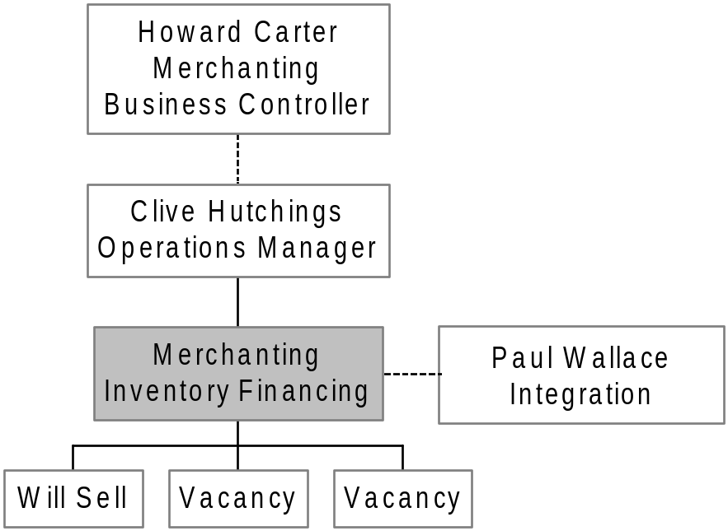
Enron Metals
Inventory Financing

